Slide 1
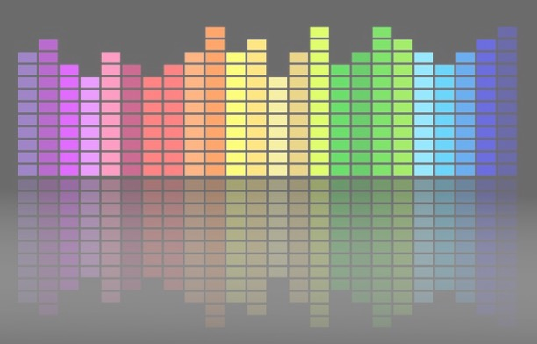

Computational Music Analysis: Audio
A.K.A. “Audio Content Analysis”
2.2 Description Of Signals
Claire Arthur
Noël Alben

Slide 2
Agenda
Review Of Blocking
Review Of Signals
Deterministic Signals vs Random Signals
Periodic Signals
Activity (Working with digital Signals In Python)
Statistical Signal Descriptions
Similarity Of Signals (Correlation)
Self-Similarity (Auto-Correlation)
Use Cases of correlation
Activity (Pseudo-Code Using Correlation)

Slide 3
Signal Categories
Deterministic Signals
predictable: future shape of the signal can be known (example: sinusoidal, DC, sawtooth)
Random Signals
unpredictable: no knowledge can help to predict what is coming next (example: white noise, waterfall)

Slide 4
Signal Categories
Deterministic Signals
predictable: future shape of the signal can be known (example: sinusoidal, DC, sawtooth)
A deterministic signal is fully predictable and can thus be expressed in a mathematical function.
For such signals the instantaneous value can be calculated for any point in time. (Eg: Fundamental Pitch of Periodic Signals, DC value)
Random Signals
unpredictable: no knowledge can help to predict what is coming next (example: white noise, waterfall)

Slide 5
Signal Categories
Deterministic Signals
predictable: future shape of the signal can be known (example: sinusoidal, DC, sawtooth)
Random Signals
unpredictable: no knowledge can help to predict what is coming next (example: white noise, waterfall)
Random or stochastic -instantaneous value (the value of the signal at a given point in time) can not be predicted.
They do not have a fundamental frequency or pitch.
Can be modeled through stochastic processes.

Slide 6

Signal Categories
Deterministic Signals
Random Signals
“Real world” signals are a combination of
(quasi-)periodic
(quasi-)random

Slide 7
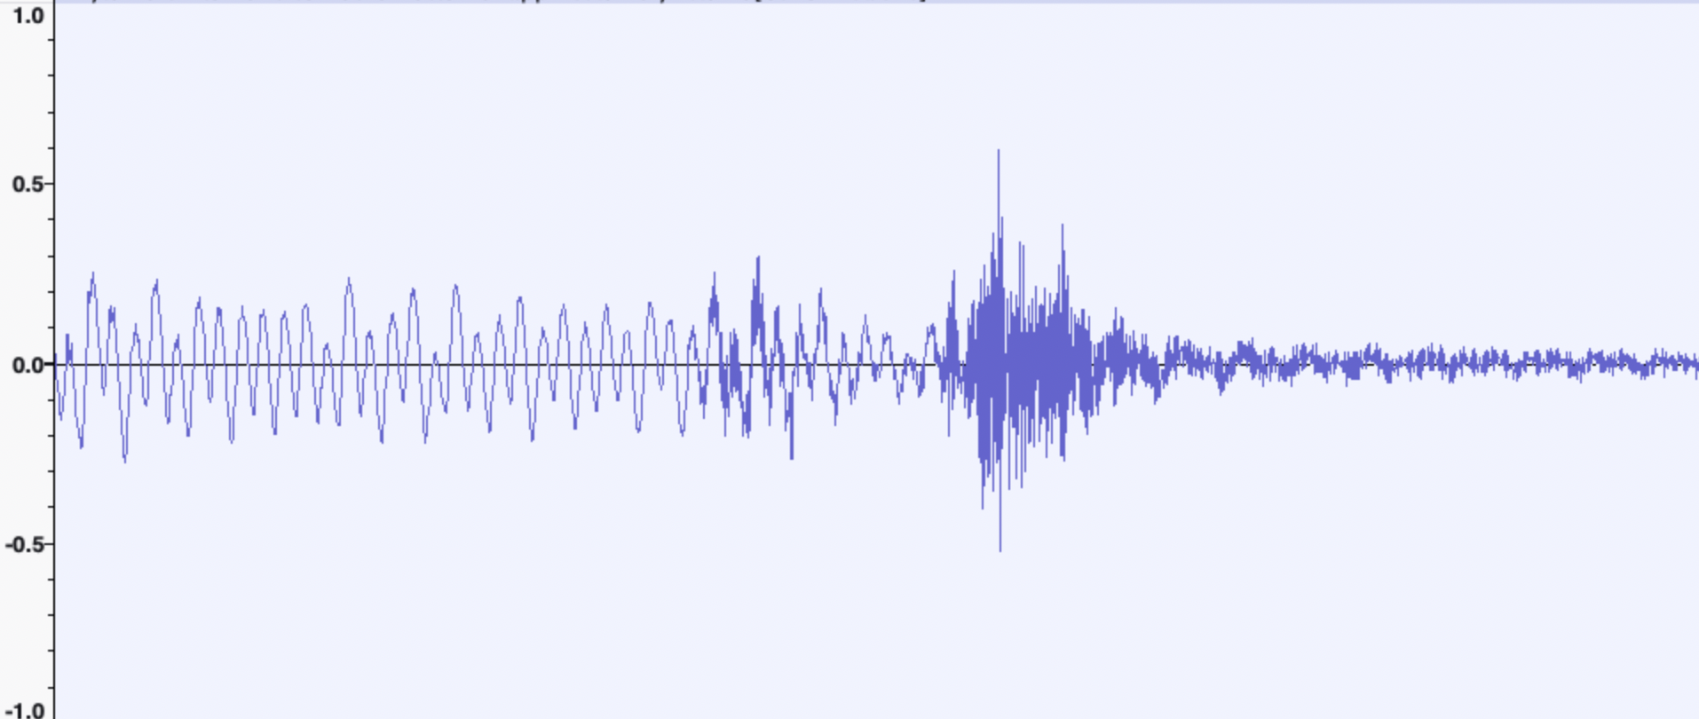
Signal Categories
Deterministic Signals
Random Signals
“Real world” signals are a combination of
(quasi-)periodic
(quasi-)random

Slide 8
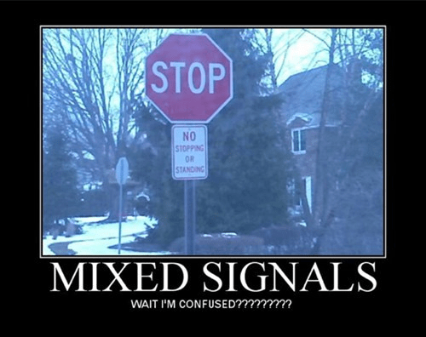
Signal Categories
Deterministic Signals
Random Signals
“Real world” signals are a combination of
(quasi-)periodic
(quasi-)random

Slide 9
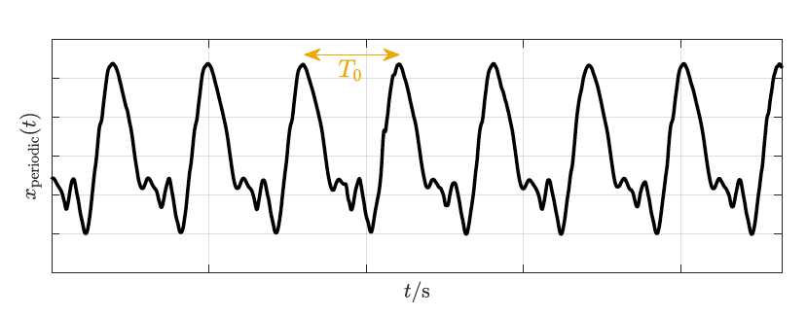
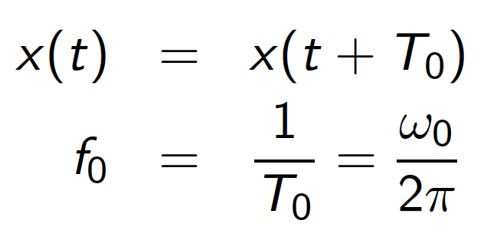
Periodic Signals
Periodic signals are the most common type of deterministic signal. All periodic signals have a fundamental frequency - 𝑓0 - the rate of repetition.
The period 𝑇0 of a periodic signal is the inverse of the frequency

Slide 10
Periodic Signals
For musical instruments and speech, the fundamental frequency is in the range of our hearing. It results in pitch, the perceptual concept related to fundamental frequency
every periodic signal can be represented in a Fourier series
Interactive Exploration: https://dev.nonety.pe/~/audio_synth_example?room=signals_interactive

Slide 11
Random Signals
Instantaneous values are indetermined, regardless of any amount of knowledge
Specific stationary behavior and properties can be expected
the frequency content (bandwidth)
value range
Mean
Interactive Exploration: https://dev.nonety.pe/~/audio_synth_example?room=signals_interactive

Slide 12
Signal Statistics
Probability Density Function/ Probability Mass Function
The Probability Density Function (PDF) of a continuous random distribution shows the relative probability of a value resulting from the given random distribution.
The discrete counter part of PDF is the PMF
x-axis: possible (amplitude) values
y-axis: probability
Activity: Plot the PMF of the following signal

Slide 13
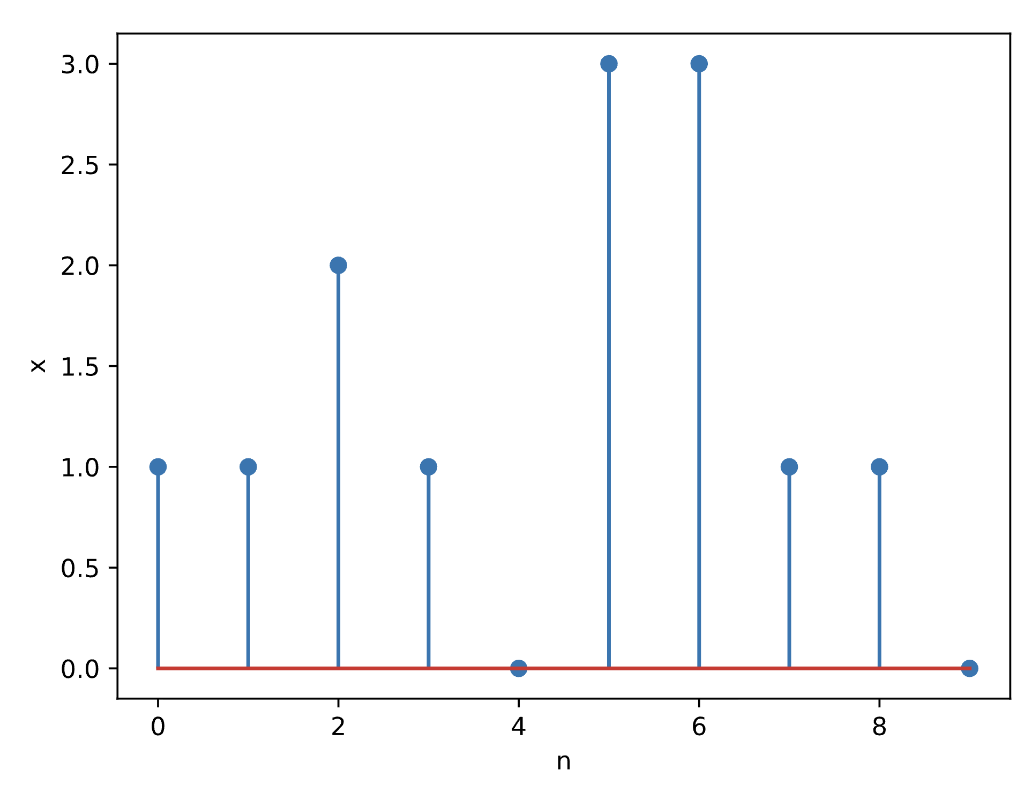
Signal Statistics
Probability Mass Function
x-axis: possible (amplitude) values
y-axis: probability
Activity: Plot the PMF of the following signal
9

Slide 14
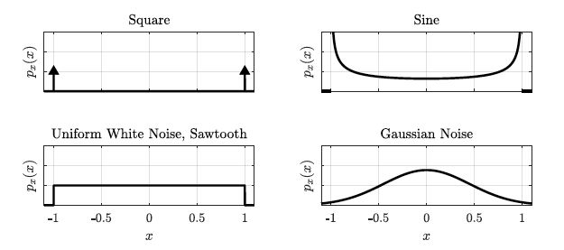
Signal Statistics
Probability Density Function Of Prototype Signals
9

Slide 15
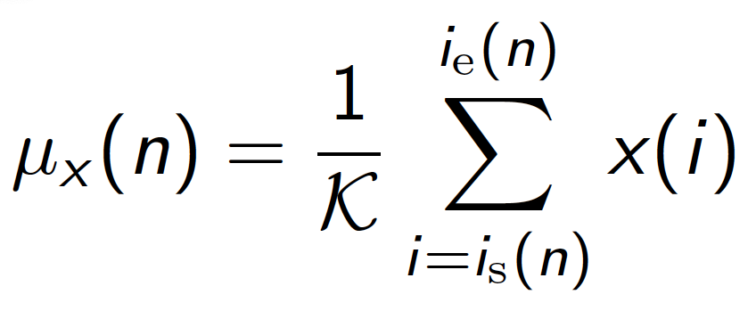
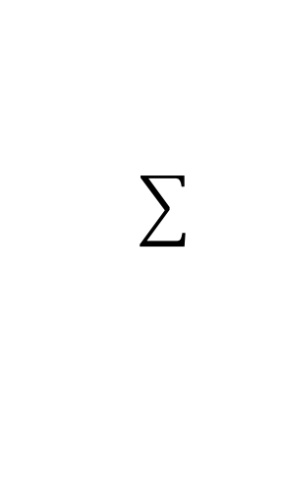
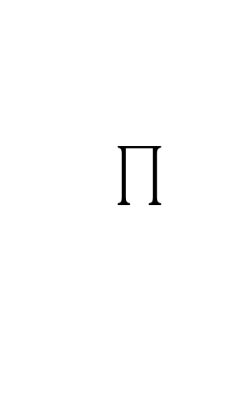
Signal Statistics
Arithmetic Mean
For a block of audio with block size K
Note:
Sum of individual elements in the array
Product of individual elements in the array
9

Slide 16
Signal Statistics
Other Descriptors
Variance
Standard Deviation
Median
Quartiles
Summarize technical signal characteristics in few numerical values
May be used on a time domain, frequency domain, or feature domain signal
We will deal with these in detail as we run into applications
9

Slide 17
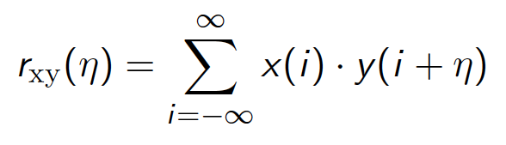
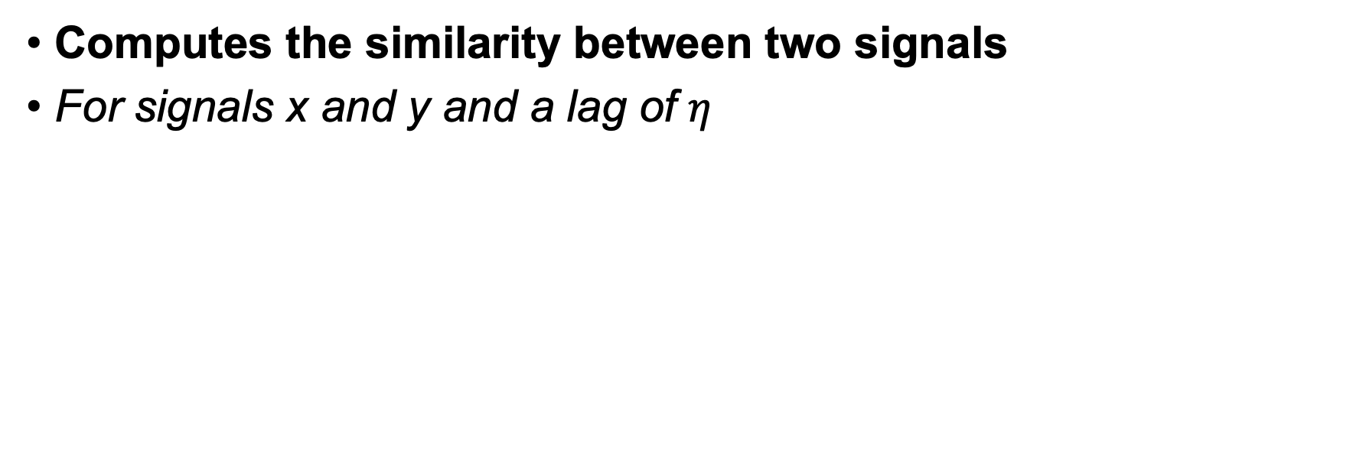
Correlation
Computes the similarity between two signals
For signals x and y and a lag of $η$
Let’s explore this notebook: https://dev.nonety.pe/~/f60625a5-0107-4cf9-b6e6-f8b9b5b6f199?room=correlation
9

Slide 18
Correlation
Use Cases For Correlation
Cross Correlation
compute similarity between different signals
detect shift between two similar but shifted signals
Auto-Correlation
detect self-similarity of (shifted) signal
detect periodicity of signal
9

